Slide 1
Tufts University
Department of Electrical and Computer Engineering
Medford, MA
EE193 Introduction to Radio Frequency Identification
RFID Class Attendance System
Submitted by: Jason Lawrence
Cameron Rossi
Candan Iuliano
Ashwin Swar
Submitted to
Professor Khaled ElMahgoub, PhD
Notes:
Candan

Slide 2
Report Table Of Contents
Class Attendance System Setup
Bill of Material
State Diagram
Video Demonstration
Conclusion
References
Notes:
Candan

Slide 3
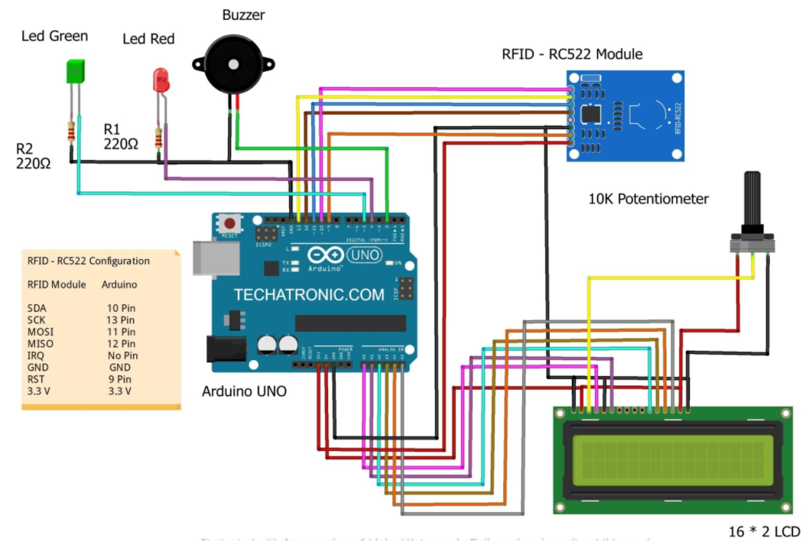
Class Attendance Block Setup
Source: https://techatronic.com/rfid-based-attendance-system-using-arduino
Notes:
Candan

Slide 4
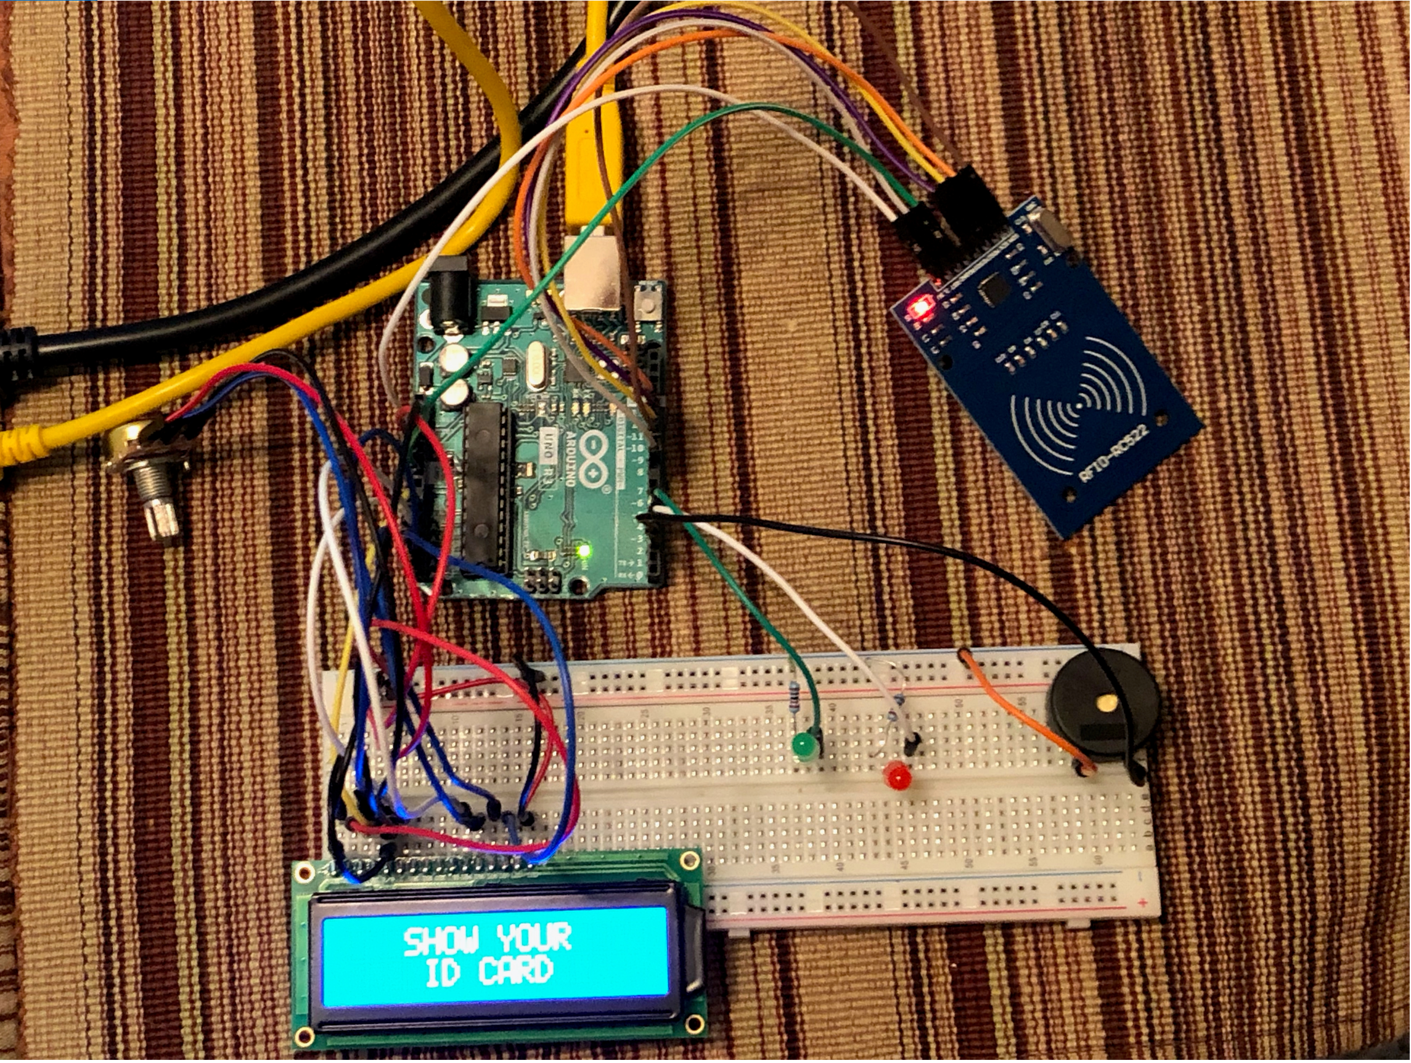
Class Attendance Setup
Notes:
Jason

Slide 5
Bill of Material
Description | QTY
Arduino Uno | 1
RC522 RFID reader Module | 1
YARONG RFID Tags 13.56 MHz Iso14443A | 11
Breadboard | 1
Red LED | 1
Green LED | 1
Buzzer | 1
16x2 LCD display | 1
10K Ohm Potentiometer | 1
220-ohm resistors | 2
Jumper wires | As required
USB cable for uploading the code to Arduino | 1
Source: https://techatronic.com/rfid-based-attendance-system-using-arduino
Notes:
Candan

Slide 6
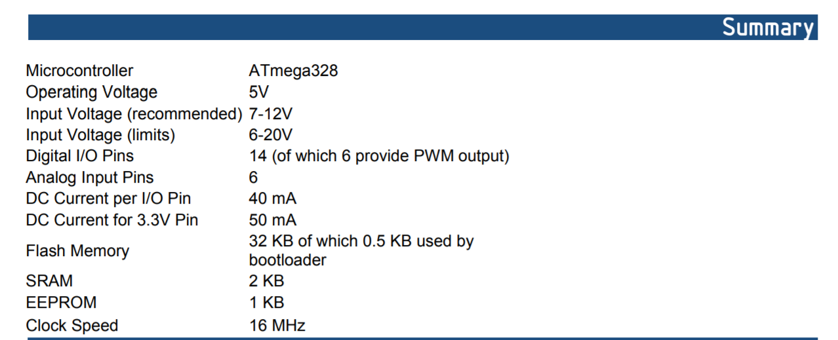
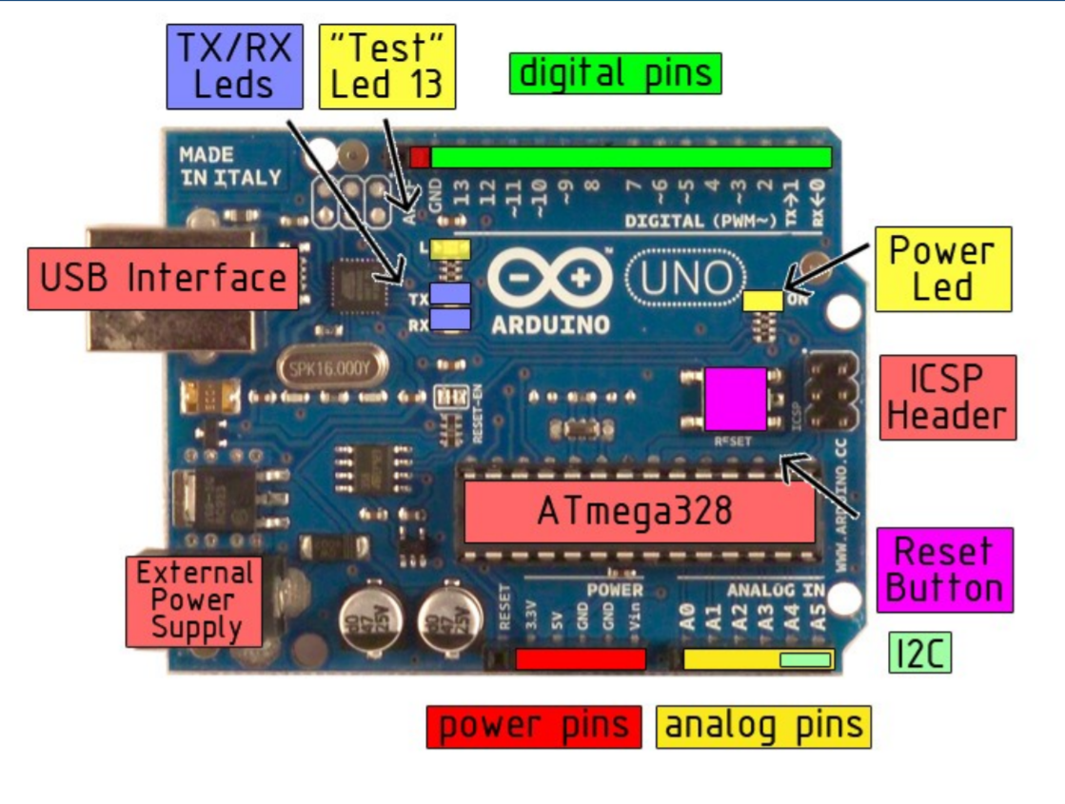
Arduino Uno Specifications
Source: https://lastminuteengineers.com/how-rfid-works-rc522-arduino-tutorial
Notes:
Jason

Slide 7
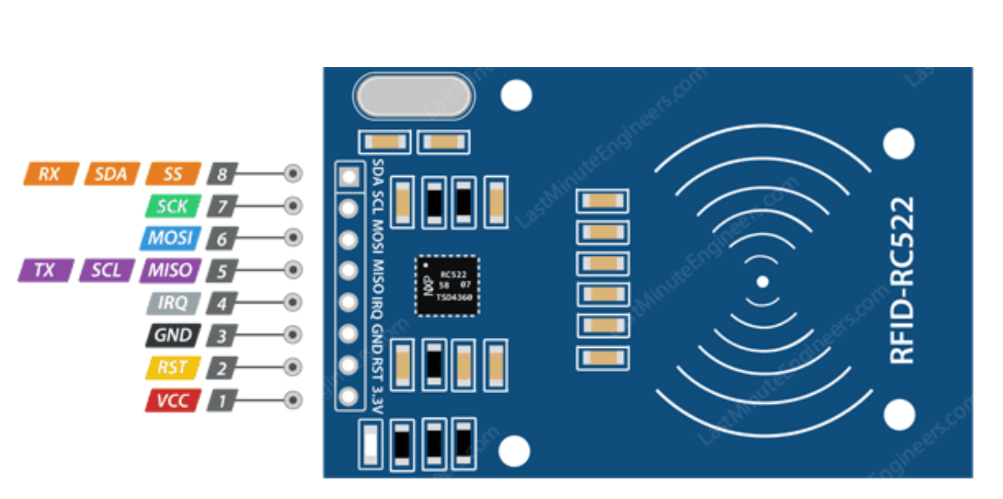
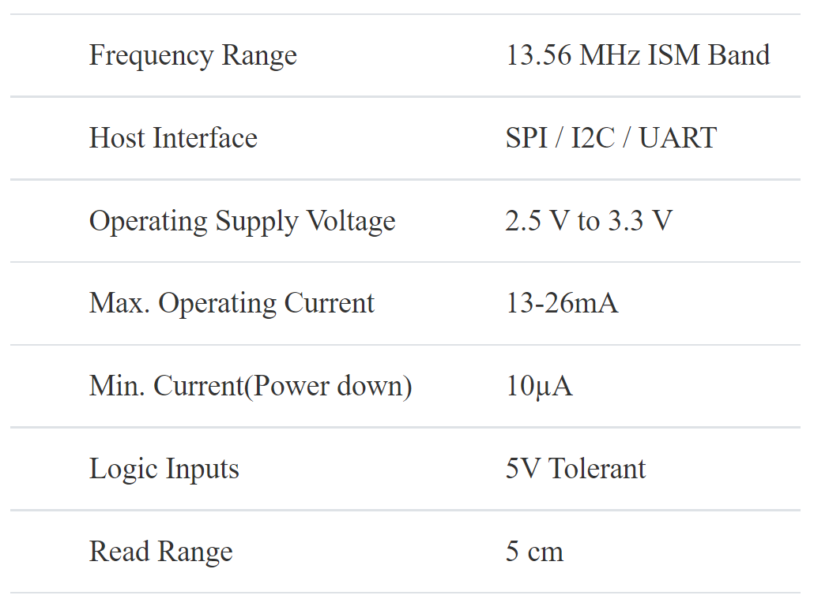
RC522 Reader Specifications
Source: https://lastminuteengineers.com/how-rfid-works-rc522-arduino-tutorial
Notes:
Jason

Slide 8
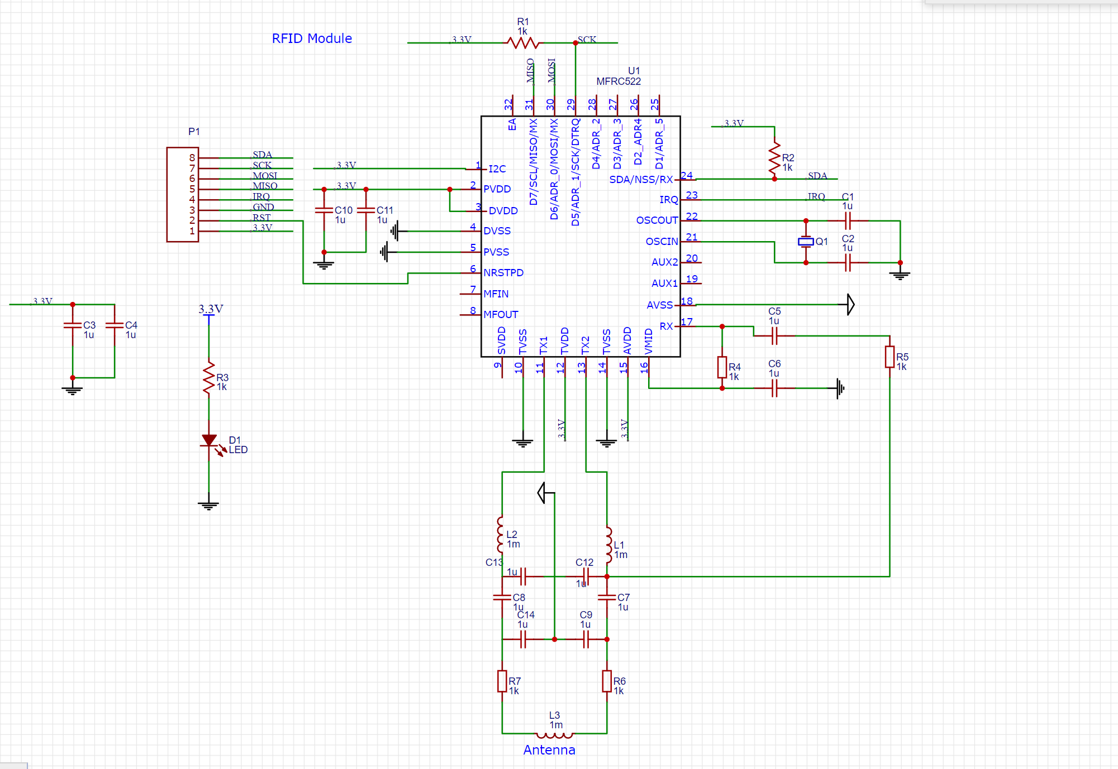
RC522 Reader Schematic
Notes:
Jason

Slide 9
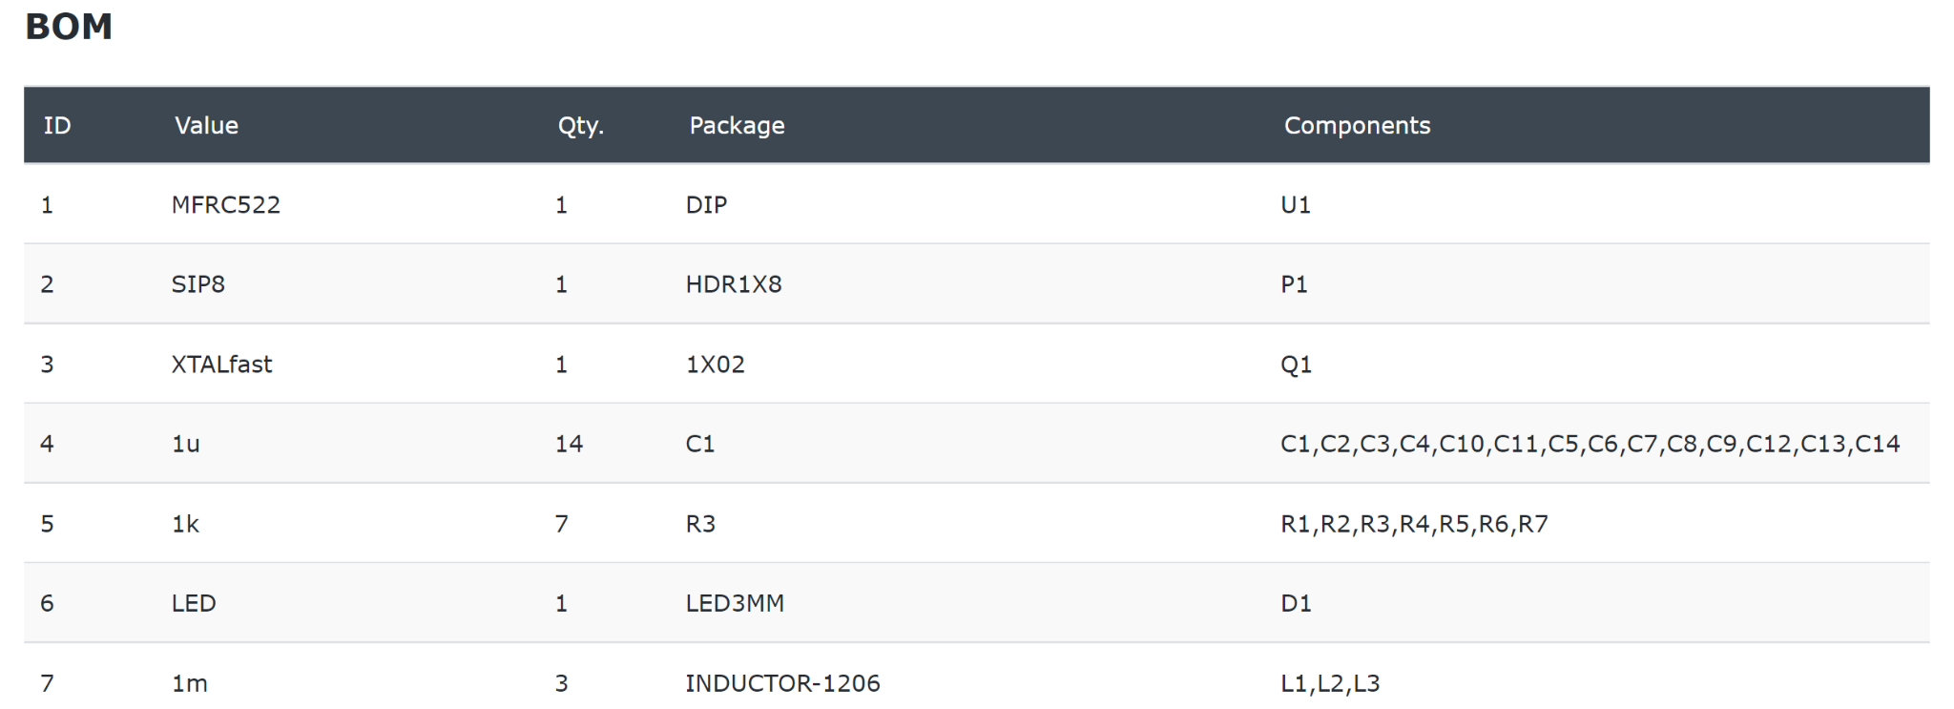
RC522 Reader BOM
Notes:
Jason

Slide 10
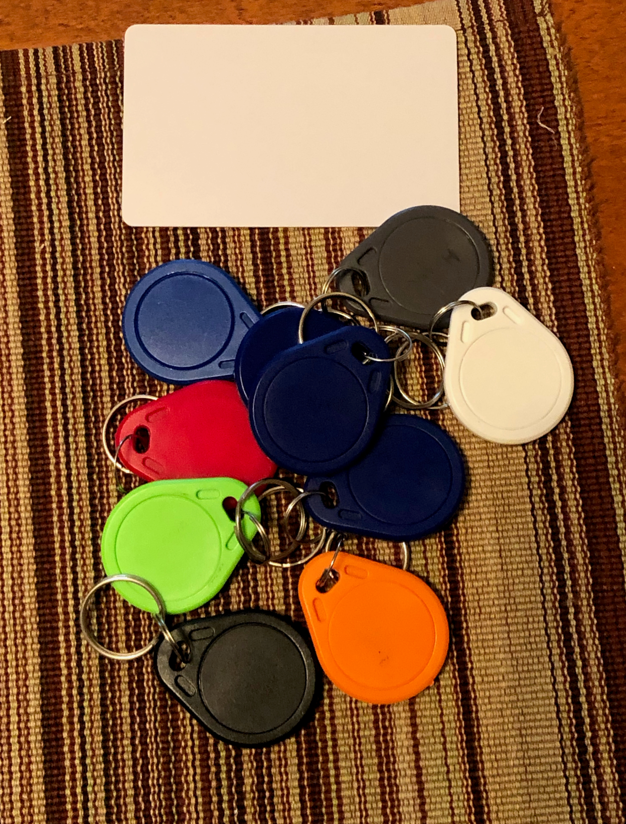
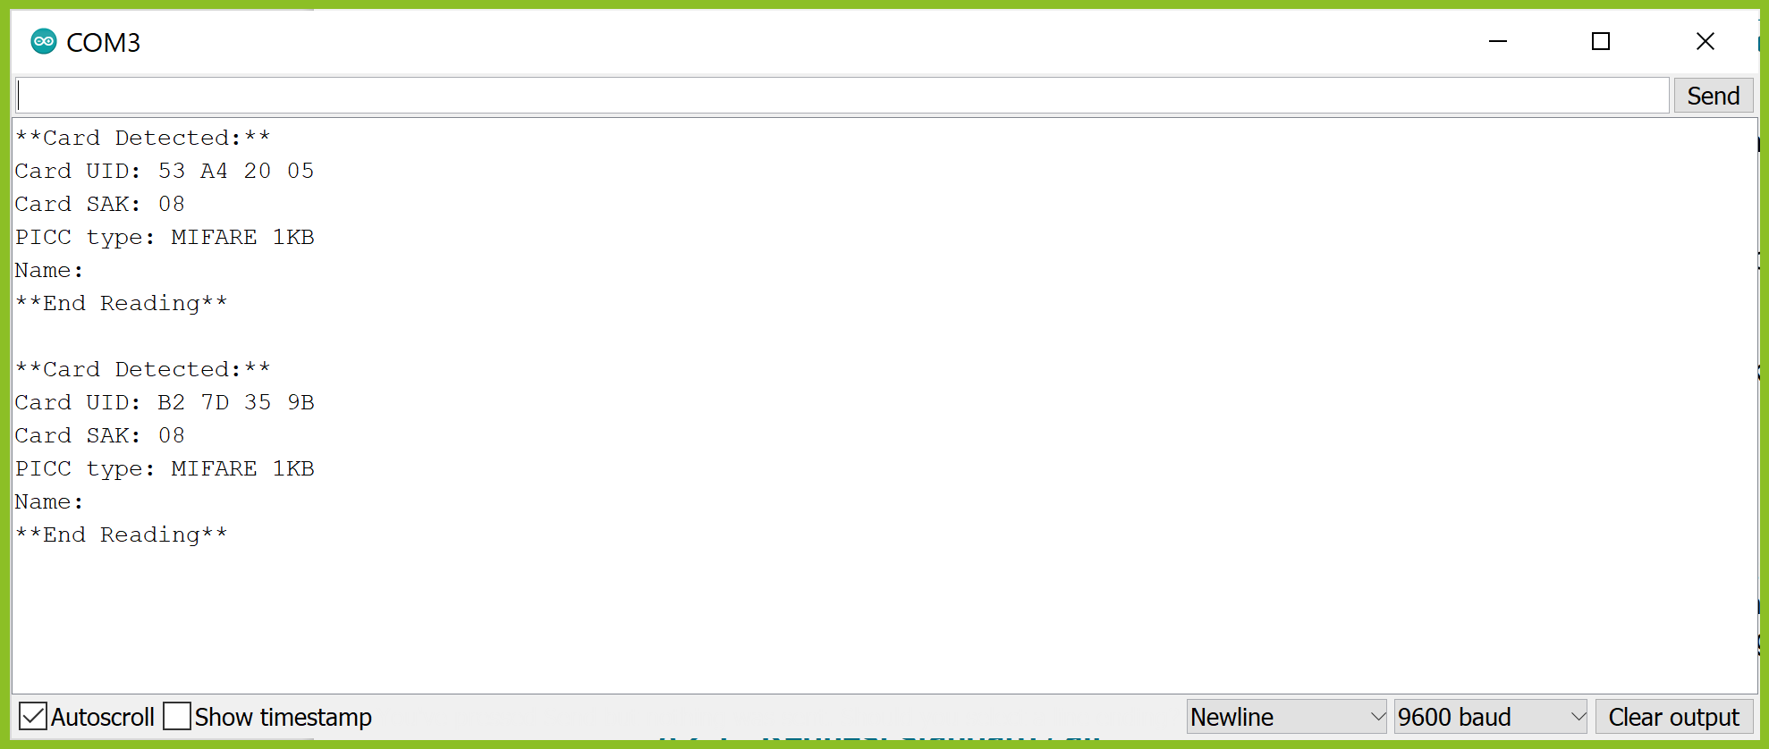
Passive RFID Tags used in Class Attendance Setup
Notes:
Cameron

Slide 11
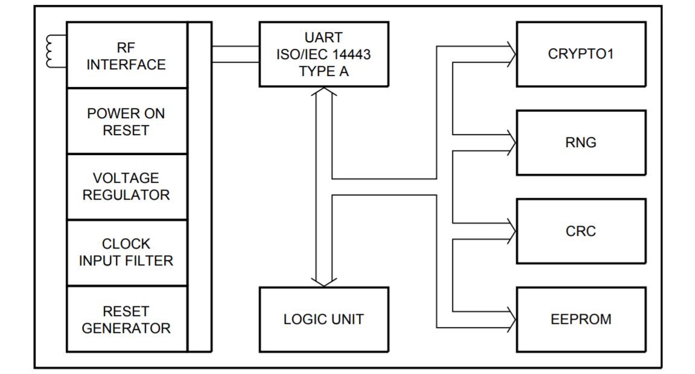
NXP’s MIFARE IC
Key Features
ISO 14443 Type A Card
1kB of user memory (EEPROM)
Data rate of 106 kbit/s
Anticollision
16 Bit CRC
Only external connection required is an antenna consisting of a loop
Notes:
Cameron

Slide 12
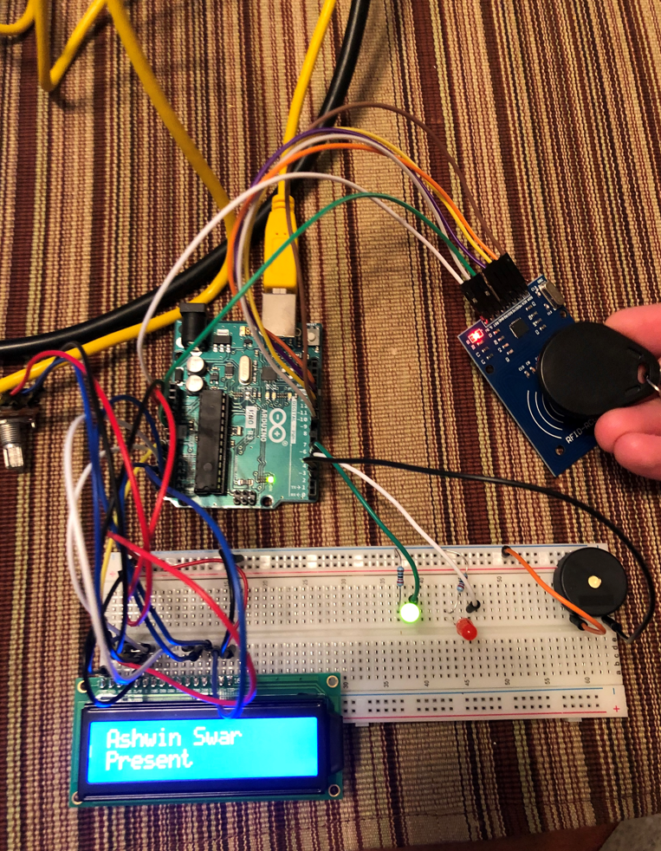
Class Attendance Setup
RFID Tag is read by the reader and student name is present on the LCD Screen
Notes:
Jason

Slide 13
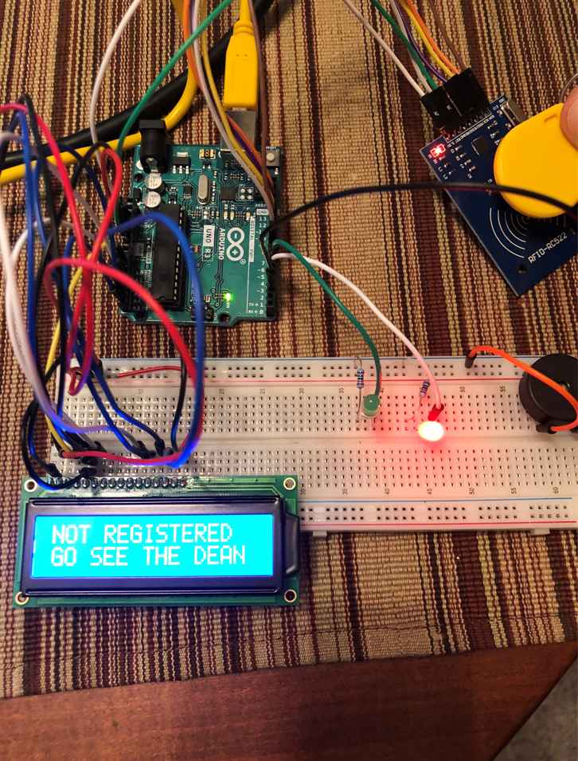
Class Attendance Setup
RFID Tag is read by the reader but the student is not registered for the class
Notes:
Jason

Slide 14
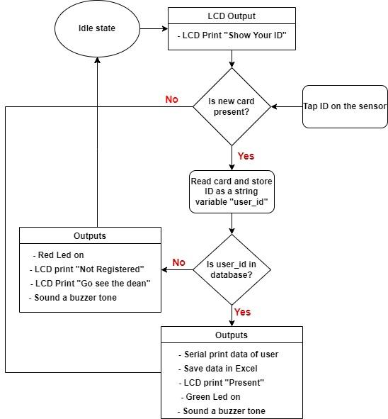
Flow chart of the Attendance System
Notes:
Ashwin

Slide 15
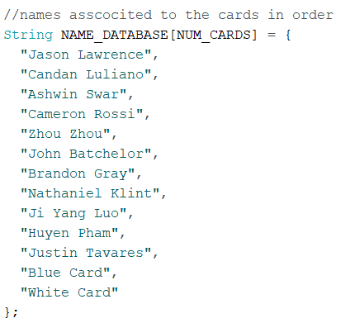
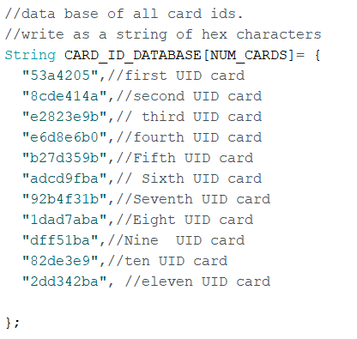
Database for Class Attendance
Starter Code Source: https://youtube/bd96662Rftg
Notes:
Ashwin

Slide 16
Code Challenges
Serial read of byte array was clumsy. It required four nested for loops.
Solution: Converted bytes to String for easy comparison
Not double counting a student.
Started with conditional logic to check but it was not clean
Solution: Used the built in function PICC_IsNewCardPresent()
Designed a function that detects if a person has already been registered
Notes:
Ashwin

Slide 17
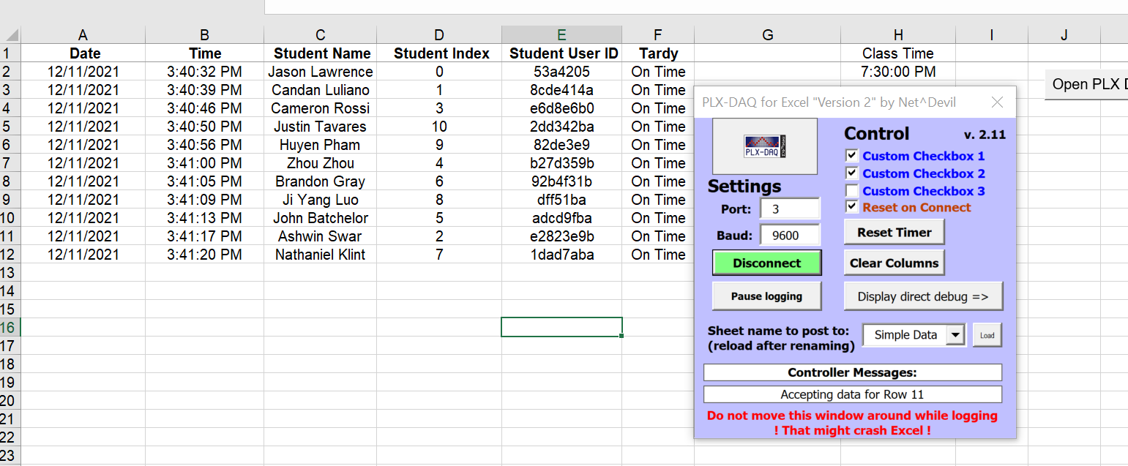
Class Attendance excel sheet
Source: https://youtu.be/bd96662Rftg
Notes:
Cameron

Slide 18
Future Work
To automatically save the attendance data in cloud for easy universal access
Use low power UHF RFID so that users don’t have to tap but can just pass by and their attendance is recorded

Slide 19

Class Attendance Video Demonstration
Notes:
Cam

Slide 20
QUESTIONS ?
Notes:
Cameron

